Slide 1

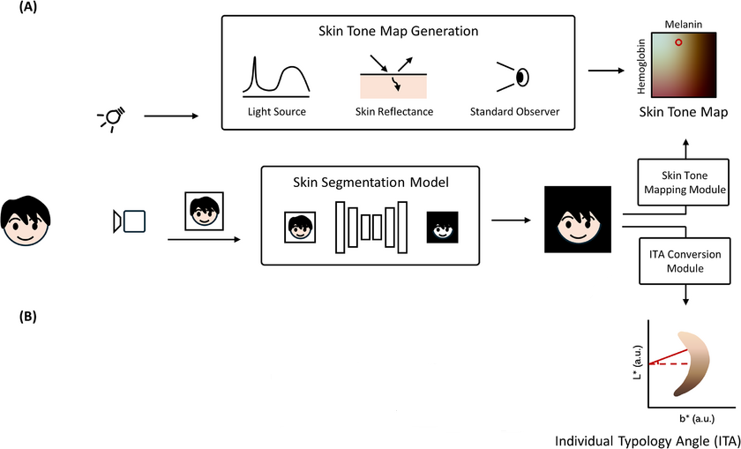
Personalized Color Correction via Skin Tone Clustering
Expectations
Develop a modular worklet or plugin for skin-tone aware color correction.
Explore and benchmark clustering approaches: k-means, GMM
Integrate perceptual tone-mapping and LUT corrections.
Design for adaptability across lighting and skin profiles.
Deliver API interface + documentation.
Training/ Pre-requisites
Basics of image processing (OpenCV)
Color space theory: RGB, HSV
Clustering algorithms: k-means ,X-means
Programming skills: Python
Machine Learning, Deep Learning
References
MDPI (2021): Personalized Color Correction Using Skin Tone Clustering
Arxiv (2025): Colors Matter: Classification of Skin Tones by Clustering https://arxiv.org/abs/2505.14931
3
Problem Statement
Traditional color correction often lacks consideration of individual skin tone variations. Leads to unnatural or biased visual outputs, especially across ethnicities or lighting setups. Skin is a visual anchor: Humans are particularly sensitive to the appearance of skin in photos. A small color shift can greatly affect perceived quality.
Demographic inclusivity: Addressing a wide range of skin tones
Objective: Implement personalized color correction by clustering skin tone regions in perceptually accurate color spaces using techniques like Worley noise.
Target applications: Mobile cameras, beauty filters, video calls
Work-let expected duration – 6 months
Students
Execution plan
Kick Off < 1st Month >
Research review, dataset collection, environment setup
Monk Skin Tone Definition
Skin Region Detection
Milestone 1 < 3rd Month >
Face/skin detection module + baseline clustering (k-means)
.
Reference tone map & Worley integration
Milestone 2 < 5th Month >
Personalized color correction logic + LUT implementation
Evaluation metrics setup: ΔE, perceptual quality tests
Closure < 6th Month >
Final prototype + UI/worklet + documentation/demo
A modular prototype Supports tone-aware, cluster-based color correction
Enhances realism and fairness in visual rendering
Ready for integration in camera pipelines, mobile apps, or filters
Amit Raj
Amit.raj2j@samsung.com
Prabodh Kumar Jana
Prabodh.kj@samsung.com

